Slide 1
Economic Implications & Limitations of Software Maintenance
Group 28

Slide 2
INTRODUCTION
The economic implications of software maintenance is a subject that has been studied for many years.
The main point is that the cost of maintaining software can be reduced by applying techniques such as automated testing and continuous integration, but these techniques cannot completely eliminate the need for manual testing.
In addition to this, it was found that the cost of maintenance can be significantly reduced if a company has an effective Software Asset Management (SAM) program in place.

Slide 3
INTRODUCTION
The cost of maintaining software, in terms of money and time, is directly related to how many people are involved in its development.
There are two ways to minimize this cost: reduce the number of people who will be involved in its maintenance or increase the amount spent on maintenance by reducing the number of bugs found and fixed during development.
Reducing the number of developers will not only mean less work for them but also less work for you as a manager. You can’t afford to spend all your time managing programmers.
Utilizing manual and automated testing from the beginning of the development process which helps prevent human error, assist in completing tasks, and aid in building scripts and performing quality assurance testing.

Slide 4
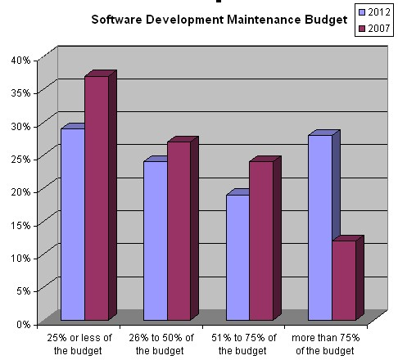
INTRODUCTION
This shows that the share of maintenance in the software development budgets is increasing, even if software development budgets are also supposed to get bigger.
A similar poll on the same topic was performed by Methods & Tools in 2007. At that time, only 36% of the participants were spending more than 50% of their software development budget for maintenance activities and only 12% were spending more than 75%.
Currently, the number of participants spending the majority of their software development budget in maintenance is 48%.
The most important change has been in the category that spends more than 75% of their budget on maintenance that has more than doubled.

Slide 5
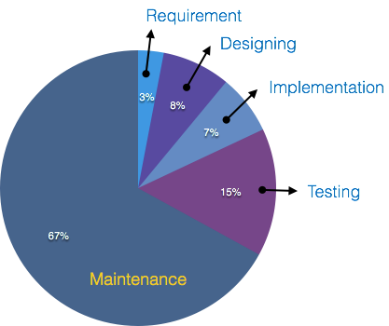
INTRODUCTION

Slide 6
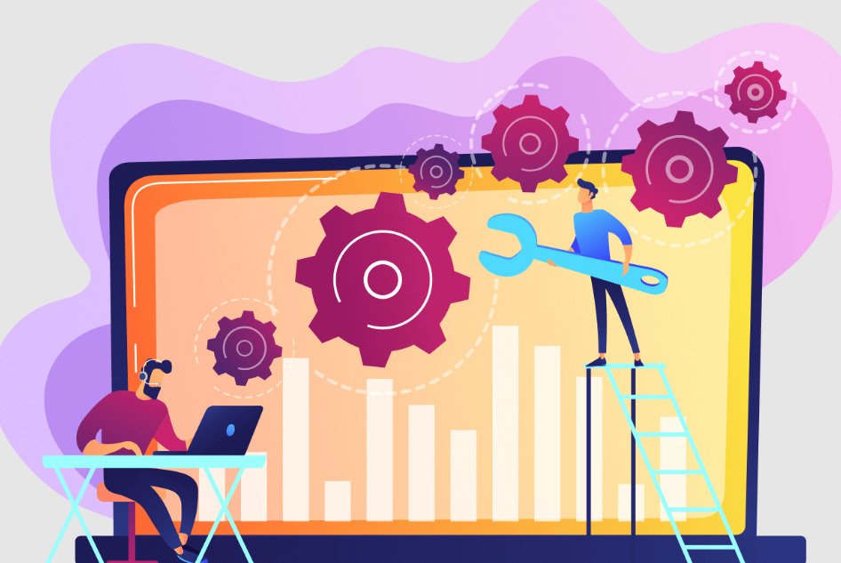
DEFINITIONS
Image - character or attributes as generally perceived.
Change - the act, process, or result of being made different in some particular
Software change : software is put into use, new requirements emerge and existing requirements change as the business running that software changes. Parts of the software may have to be modified to correct errors that are found in operation, improve its performance or other non-functional characteristics.

Slide 7
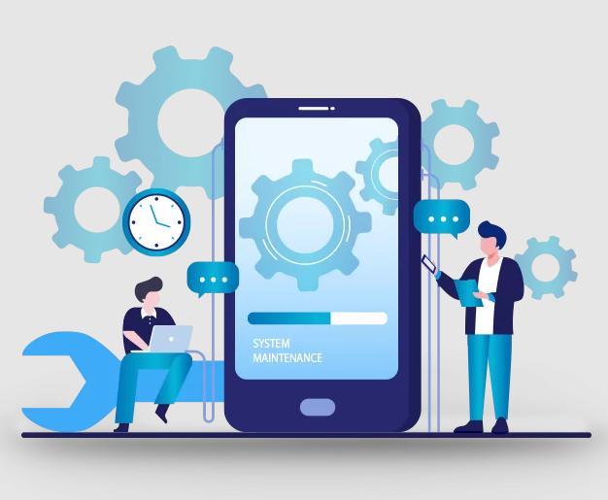
Corrective change:- Corrective change refers to modification initiated by defects in the software. A defect can result from design errors, logic errors and coding errors.
Design errors occur when, for example, changes made to the software are incorrect, incomplete, wrongly communicated or the change request is misunderstood.
Logic errors result from invalid tests and conclusions, incorrect implementation of design specifications, faulty logic flow or incomplete testing of data.
Coding errors are caused by incorrect implementation of detailed logic design and incorrect use of the source code logic. Defects are also caused by data processing errors and system performance errors
Preventive change - The long-term effect of corrective, adaptive and perfective changes is expressed in Lehman's law of increasing entropy Work done on a software system to address problems of deteriorating structure is known as preventive change.

Slide 8
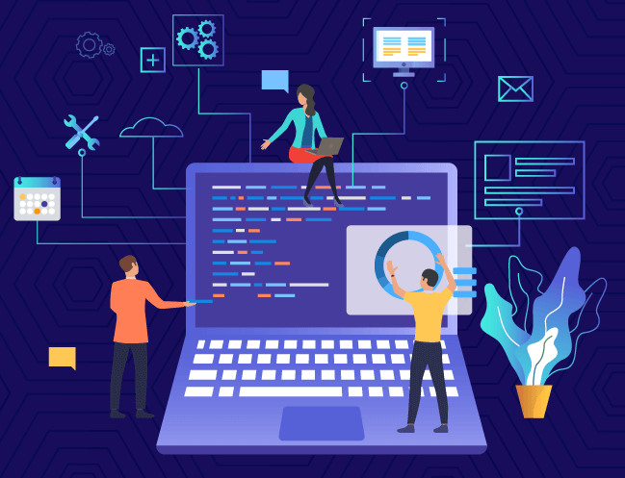
Maintenance crisis - The current predicament where the demand for high quality sophisticated software systems far outstrips the supply of such systems, but existing systems lack the capacity to evolve appropriately with technological advancement.
E-type system - a system in which the criteria for acceptability is that stakeholders are satisfied with the system in terms of its performance in a real world situation.
On-going support - a service offered to customers to assist their continuing use of a product.
Post-delivery evolution - software evolution referring explicitly to the period after the product is delivered to the customer.
Ripple effect - consequences of an action in one place, occurring elsewhere e.g. a stone dropped in a pond resulting in waves / ripples far from the point of impact.
S-type system - a system in which the criteria for acceptability is that it is correct relative to an absolute specification.
Software evolution - the tendency of software to change over time.

Slide 9
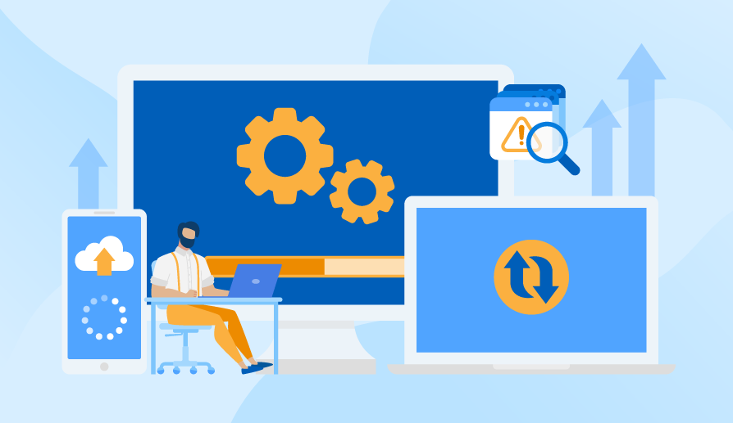
ECONOMIC IMPLICATIONS OF MODIFYING LEGACY SOFTWARE

Slide 10
THE COST OF MAINTAINING LEGACY SYSTEMS: HOW MUCH DO YOU OVERPAY?
Despite the onslaught of revolutionary digital trends and technological advances, many companies still use legacy systems. This may sound puzzling at first glance. Why would any modern company want to stick to outdated legacy systems?
For instance, government agencies, national banks, and other financial institutions still use legacy systems today. Most companies who choose to maintain their legacy systems do so for presumably good reasons. These systems are quite efficient and allow continuity in business operations. Some may even argue that the cost of legacy software maintenance is cheaper than updating to modern alternatives.
Unfortunately, maintenance expenses represent only a tiny piece of the entire cost. A more in-depth analysis of the cost of maintaining legacy systems vs. updating the systems would show that the former is considerably more expensive.
In this section of the presentation we will discuss the hidden cost of maintaining legacy systems and how much you overpay to keep them running.

Slide 11
HOW MUCH YOU OVERPAY TO MAINTAIN YOUR LEGACY SOFTWARE
Although it may seem like you’re saving costs when you don’t spend resources updating your software it costs more in the long run. According to a study on the cost of maintaining legacy systems in the United States, ten of the government’s legacy systems cost about $337 million a year to operate and maintain.
Legacy systems can cost any organization up to a 15% budget increase every year for maintenance. As a result, modernizing your legacy software might be a better alternative due to the risks and cost implications of maintaining outdated software. However, it still needs to be done right, as there are some common mistakes in legacy software modernization you need to avoid to succeed.

Slide 12
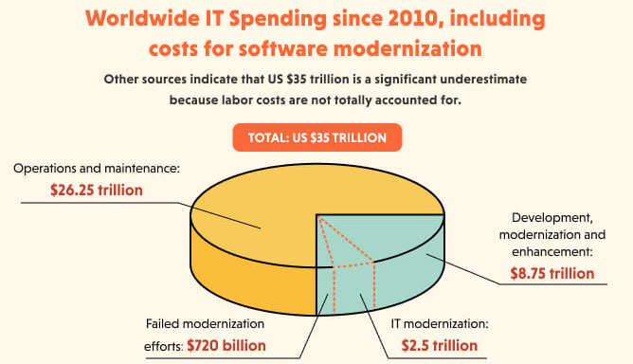

Slide 13
THE MAIN COST OF LEGACY SYSTEMS
Previous studies have shown that organizations have been spending large sums of money supporting, maintaining, and implementing legacy software. Statistics have also revealed that banks and insurance companies dedicate up to 75% of their IT budgets to preserving their legacy systems.
As a result, companies should evaluate the financial risk factor of maintaining their legacy systems compared to updating to modern solutions like SaaS and PaaS.

Slide 14
THE MAIN ON-SURFACE COST OF LEGACY SYSTEMS INCLUDE:
Resources for ongoing management
Legacy systems require constant attention and resources so that the outdated solution does not cause any major failures. With time, it will also be harder and harder to find knowledgeable professionals able to manage the system effectively.
The need for highly skilled tech support
Troubleshooting a legacy system requires a high level of expertise. Moreover, skilled tech support help might be needed to employ a newer tool to ensure compatibility with the legacy system.
Requirements for special licensing
In some cases, discontinued legacy solutions require special licensing to be used. For example, the US Navy pays millions of dollars to keep safely using Windows XP on their system

Slide 15
6 HIDDEN COSTS OF MAINTAINING
LEGACY SYSTEMS
Generally, using and maintaining legacy systems come with a significant decrease in performance and profitability. However, there are several other hidden costs submerged under the general umbrella of stunted performance.
These costs appear in various business areas, including data security, customer experience, employee experience, skill acquisition, performance, and productivity.
Despite being ‘hidden’ from plain sight, these costs can hinder business operations or even grind them to a halt. Let’s go ahead and discuss the hidden costs in detail.

Slide 16
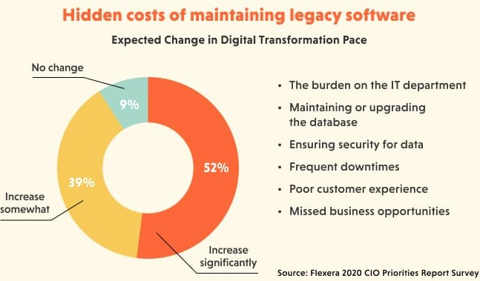

Slide 17
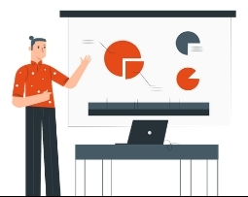
1-THE BURDEN ON THE IT DEPARTMENT
Maintaining or working with outdated legacy systems can put a considerable strain on the IT department and impair productivity.
Since the system contains bugs, the entire workload will focus on finding and fixing these bugs instead of mission-oriented projects.
In the long run, this could lead to an increase in the number of dissatisfied employees and a corresponding decrease in performance levels.

Slide 18
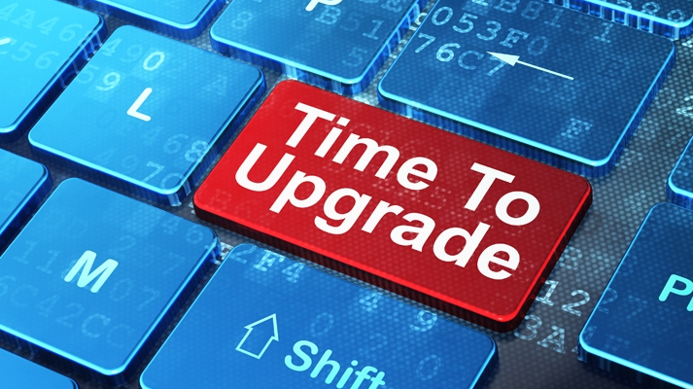
2-MAINTAINING OR UPGRADING THE DATABASE
Data is the driving force for any operation within the company. Legacy systems often lack a centralized data processing module. Even those with data processing systems have a disorganized framework. As a result, most companies often have to spend a sizable fortune on upgrading legacy system databases.
Besides, legacy databases like Microsoft Access or SQL Server are a challenge to turn into a competitive advantage albeit easy to set up. And failure to configure them may lead to significant data loss and damage your brand’s reputation beyond repair

Slide 19
3-ENSURING SECURITY FOR DATA
Legacy systems are not secure enough, which is especially critical as long as every modern company handles users’ confidential information to operate. These systems come with several hard-to-fix vulnerabilities, which could lead to a data breach or total loss of data.
The most notable example is the BlueKeep security vulnerability that affected NT-based Microsoft OS. Although Microsoft released patches later, the damage had already been done. Eventually, the affected companies still needed to pay extra fees to upgrade the security protocols and replace the lost data.
This necessitates constant security upgrades and maintenance checks. An easy solution to these problems associated with legacy systems would be to migrate your software from desktop to web or provide cloud migration. This way, your company can perform efficiently and productively. Maintaining outdated legacy software will require your IT staff to undergo special training to equip themselves with the necessary skills.

Slide 20
4 & 5-FREQUENT DOWNTIME AND POOR CUSTOMER EXPERIENCE
Frequent downtimes
Legacy systems may frequently experience downtime, which could wreak havoc on departments or cause financial losses to the company. For instance, if you are running an accounting legacy software, downtime during work hours could freeze cash inflow and prevent your business from generating revenue.
Poor customer experience
In several instances, low-performing legacy systems have led to dissatisfied customers and reduced cash inflow for the company involved. For instance, in 2015, a Paris airport was shut down after a 23-year-old Windows 3.1 system crashed in bad weather. Planes were grounded for several hours, with disgruntled customers left stranded.
The customer experience is vital to any company’s success in today’s competitive market, and as such, using legacy systems is detrimental to your business.

Slide 21

6-MISSED BUSINESS OPPORTUNITIES
Up-to-date software empowers your business growth as it includes new features that boost process optimization, better data flow, and analysis, or even overall productivity which results in revenue growth.
The newest software development trends focus on better integration and interconnectivity between parts of the system and deeper processes automation. If you miss out on them, you will lose many resources you might’ve saved and repurposed.

Slide 22
Limitations To Software Change
Resource Limitation
Quality of the Existing System
Organisational Strategy
Inertia
Attracting and Retaining Skilled Staff

Slide 23
Nomenclature and Image Problems
The use of the word "maintenance" to describe activities undertaken on software systems after delivery has been considered a misnomer due to its failure to capture the evolutionary nature of software products.

Slide 24
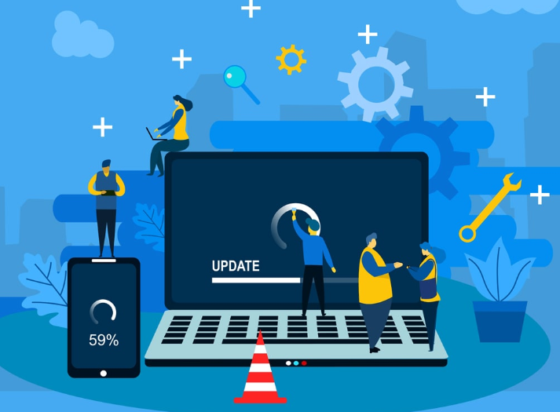
Software evolution and post delivery evolution
Software evolution and post-delivery evolution are similar because they both describe the tendency of software to evolve and they are used synonymously by many authors.
Thus, software evolution can refer to any phase of the evolution, including those preceding delivery of the software.

Slide 25
“maintenance”
It can be argued that there is nothing wrong with using the word "maintenance" provided software engineers are educated to accept its meaning within the software engineering context, regardless of what it means in non-software engineering disciplines.

Slide 26

Potential solutions to maintenance problems
Budget and effort reallocation - reassigning maintenance resources to develop more maintainable systems
Complete replacement of existing systems
Enhancement of existing systems

Slide 27
BUDGET AND EFFORT REALLOCATION
Based on the observation that software maintenance costs at least as much as new development, some authors have proposed that rather than allocating less resource to develop unmaintainable or difficult-to- maintain systems, more time and resource should be invested in the development - specification and design - of more maintainable systems.
The use of more advanced requirement specification approaches , design techniques and tools , quality assurance procedures and standards such as the ISO 9000 series and maintenance standards are aimed at addressing this issue. It is believed that the deployment of these techniques, tools and standards earlier on in the development life-cycle will lead to more maintainable systems.

Slide 28
COMPLETE REPLACEMENT OF EXISTING SYSTEM
After having examined the problems that the maintenance of legacy systems poses for many medium-size to large organisations, particularly their unwelcome economic impact on the software budgets of these organisations, one might be tempted to suggest that if maintaining an existing system costs as much as developing a new one, why not develop a new system from scratch?
CONSTRAINTS :-
Economic constraints
Residual errors in the new systems
Database of information

Slide 29
MAINTENANCE OF THE EXISTING SYSTEM
Complete replacement of the system is not usually a viable option. The 'budget/effort reallocation' approach, though theoretically convincing, is somewhat difficult to pursue. Even if the latter were possible, it would be too late for systems that are already in what is being termed the maintenance crisis.
As an alternative, the current system needs to have the potential to evolve to a higher state, providing more sophisticated user-driven functionality, the capability of deploying cutting edge technology, and of allowing the integration of other systems in a cost-effective manner. A number of techniques, methods, tools and management practices are used to meet these goals.

Slide 30
CONCLUSION
The high expenditure on software maintenance is partly due to the evolutionary nature of software products and partly due to other problems such as badly structured code, incomplete or non-existent documentation, staff turnover and changes in the environment of the product.
Possible solutions to the maintenance problems include:
(i) investing more resources during the earlier phases of the software life-cycle so as to develop more maintainable systems. This may be achieved by the use of evolutionary development paradigms, although these are not yet proven to be practical;
(ii) complete replacement of the existing system. However the latter, though sometimes necessary, is not usually economically viable.

Slide 31
MEMBERS
GROUP 28
RITIK SINGH - 2K19/CO/319
ANUPAM - 2K19/SE/013
ADITHYA KRISHNAN - 2K19/SE/002
AJAY KUMAR DHURWE - 2K19/SE/004
AKHILESH GAUTAM - 2K19/SE/005
ANKIT KUMAR MISHRA - 2K19/SE/010

